Slide 1

PsychoPy: An Introduction
Jibo He
Department of Psychology
jibo.he@wichita.edu

Slide 2
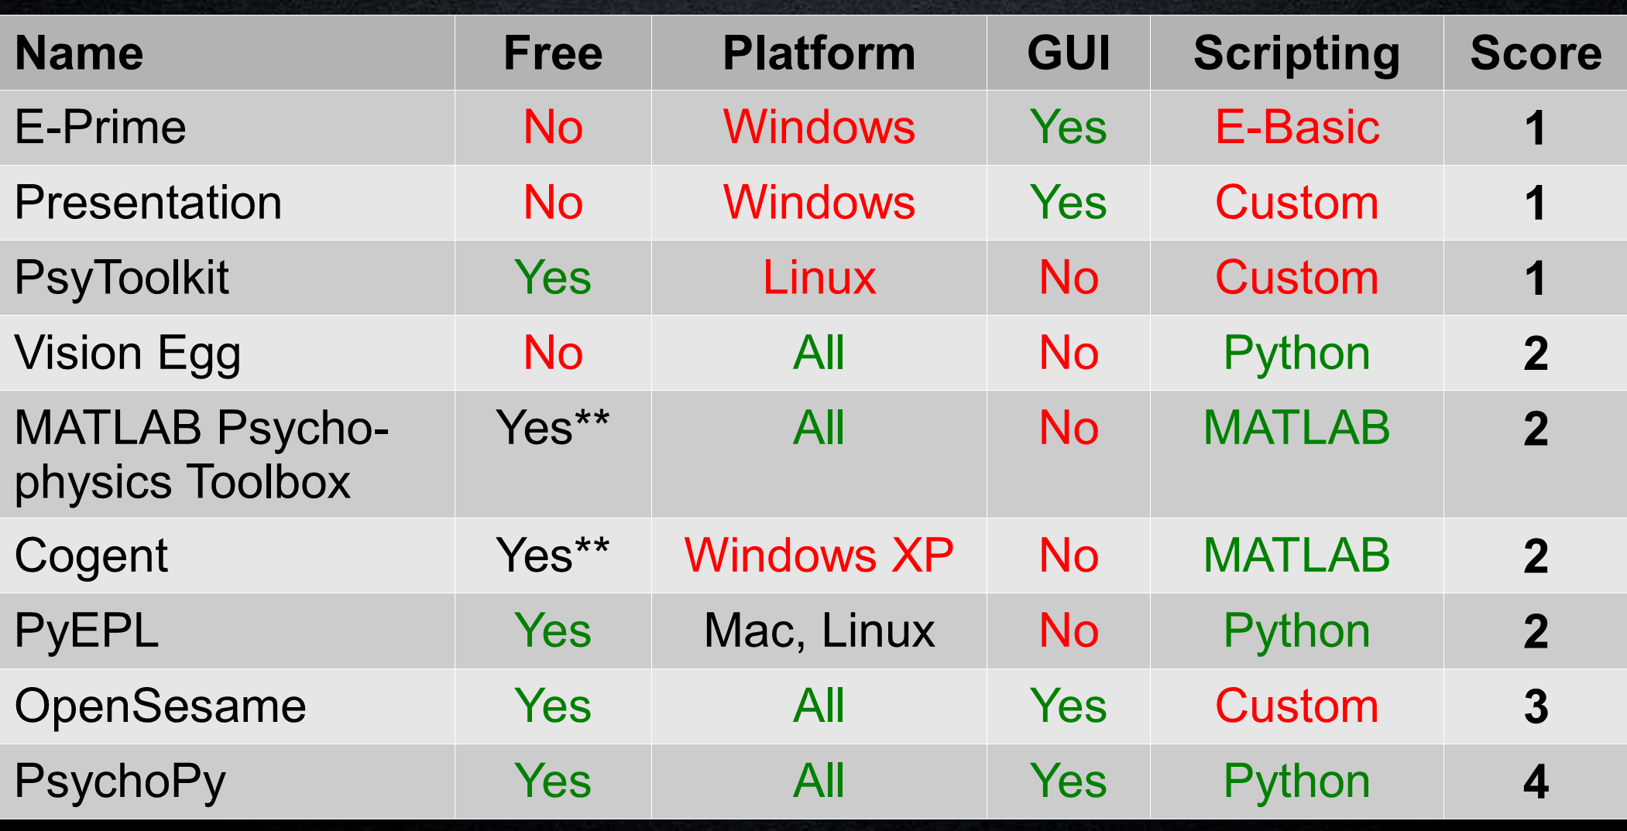
Experiment Design Software
Adapted from Mathôt, S., Schreij, D., & Theeuwes, J. (2011). OpenSesame: An
open-source, graphical experiment builder for the social sciences. Behavior
Research Methods.

Slide 3
Additional Reasons to Choose PsychoPy
Timing to frames: ability to time-lock visual
stimuli to monitor frames instead of milliseconds.
Actual stimulus appearance: specify/calibrate
monitor properties and use ”deg” as unit.
Power of Python: statistics, visualizations or web?
Only an ”import” away!
Active development:updates about every month.
Fast bugfixing.

Slide 4
About PsychoPy
Peirce, JW (2007) PsychoPy - Psychophysics software in Python. J Neurosci Methods, 162(1-2):8-13
Peirce JW (2009) Generating stimuli for neuroscience using PsychoPy. Front. Neuroinform. 2:10. doi:10.3389/neuro.11.010.2008

Slide 5
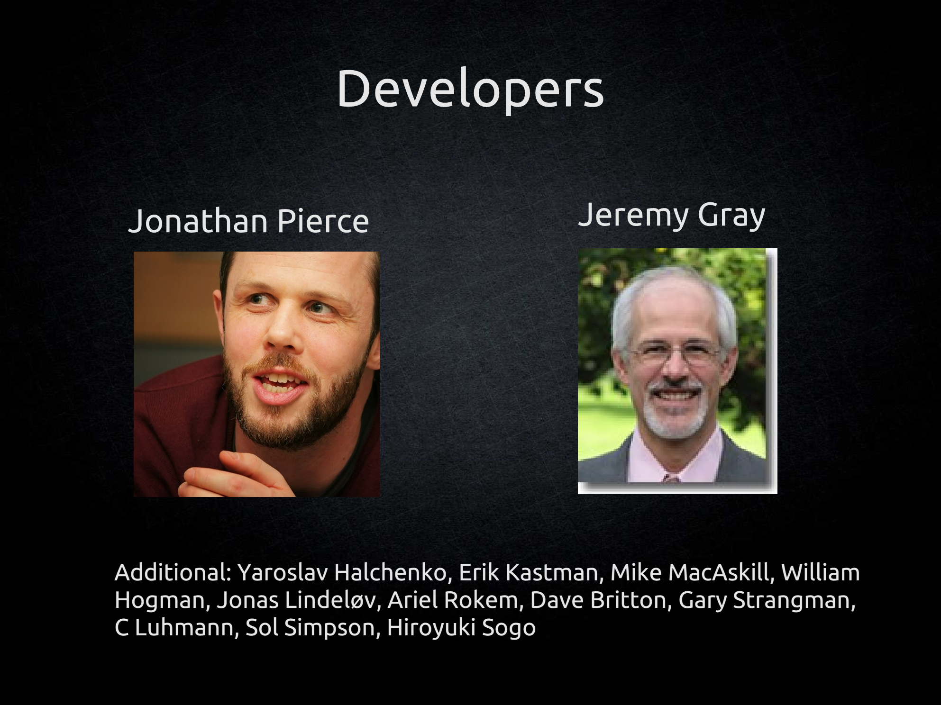

Slide 6
ask for help
mail list:
  https://groups.google.com/forum/#!forum/psychopy-users
Document:
  http://www.psychopy.org/PsychoPyManual.pdf

Slide 7
Install PsychoPy
download link:
  http://www.psychopy.org/
  http://sourceforge.net/projects/psychpy/files/PsychoPy/
  http://www.psychopy.org/installation.html#mac-os-x

Slide 8
Install PsychoPy for Windows
download link:
  http://www.psychopy.org/
  http://sourceforge.net/projects/psychpy/files/PsychoPy/
  http://www.psychopy.org/installation.html#mac-os-x

Slide 9
Install PsychoPy for Linux/Unix
download link:
  http://www.psychopy.org/
  http://sourceforge.net/projects/psychpy/files/PsychoPy/
  http://www.psychopy.org/installation.html#mac-os-x

Slide 10
Install PsychoPy for Mac
download link:
  http://www.psychopy.org/
  http://sourceforge.net/projects/psychpy/files/PsychoPy/
  http://www.psychopy.org/installation.html#mac-os-x

Slide 11
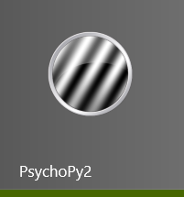
Start PsychoPy
Find the "PsychoPy2" in the Start Menu.

Slide 12
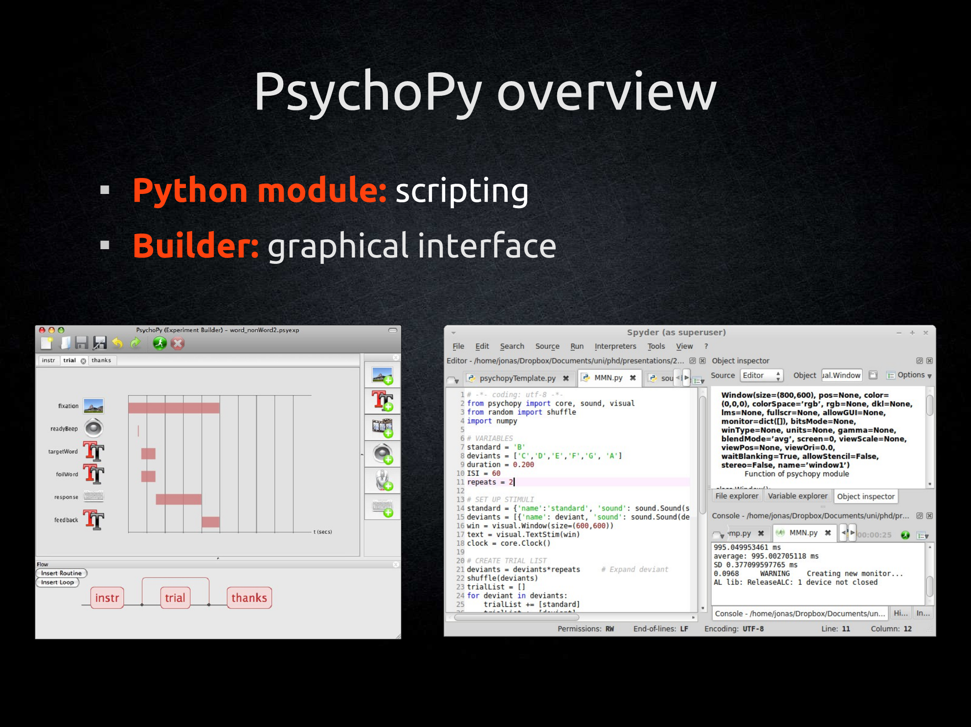

Slide 13
Get your familiar tools in Python
MATLAB:
  import numpy as np
MATLAB plotting:
  import matplotlib as plt
R data.frame:
  import pandas as pd

